Slide 1
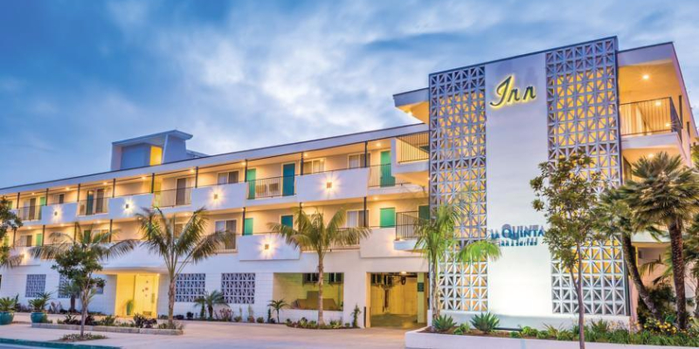
The Rise and Fall of La Quinta Inn & Suites by Wyndham: An Analysis
Team: Just here for Snacks!!
Members:
Urvi Vaidya, Katherine Yu, Xu Wang, Joanna Sun, Jiarui Song

Slide 2
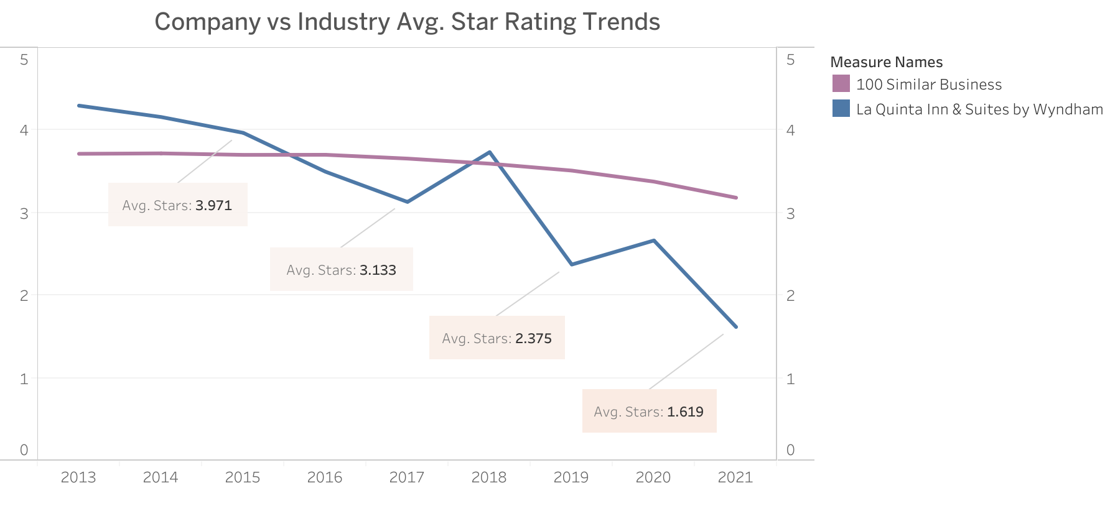
The Rise and Fall of La Quinta Inn & Suites by Wyndham
Scenario:
We are exploring the factors that contributed to the rise and eventual decline of LQI in popularity from a customer perspective
La Quinta Inn & Suites
100 Similar Business
From year 2013 to 2015, the hotel guests indicated satisfaction towards the amenity, such as the room space and bathroom furnishings, as well as the location
Since 2018, people complained about the sanitation conditions, service manners, and noise due to an ongoing construction, which imply the declining trend of the star ranking throughout the years.

Slide 3
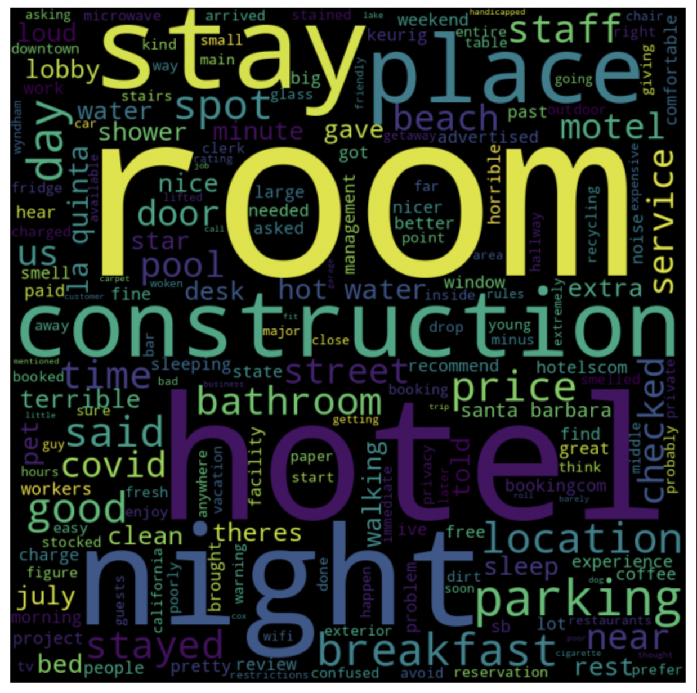
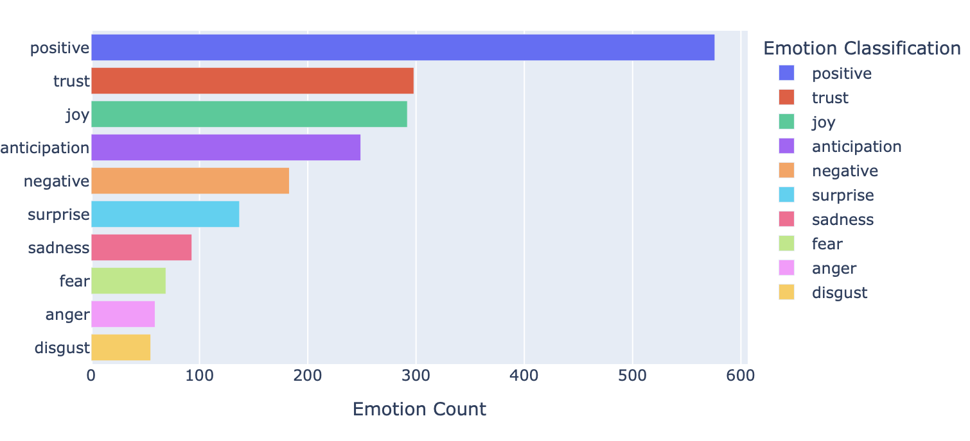
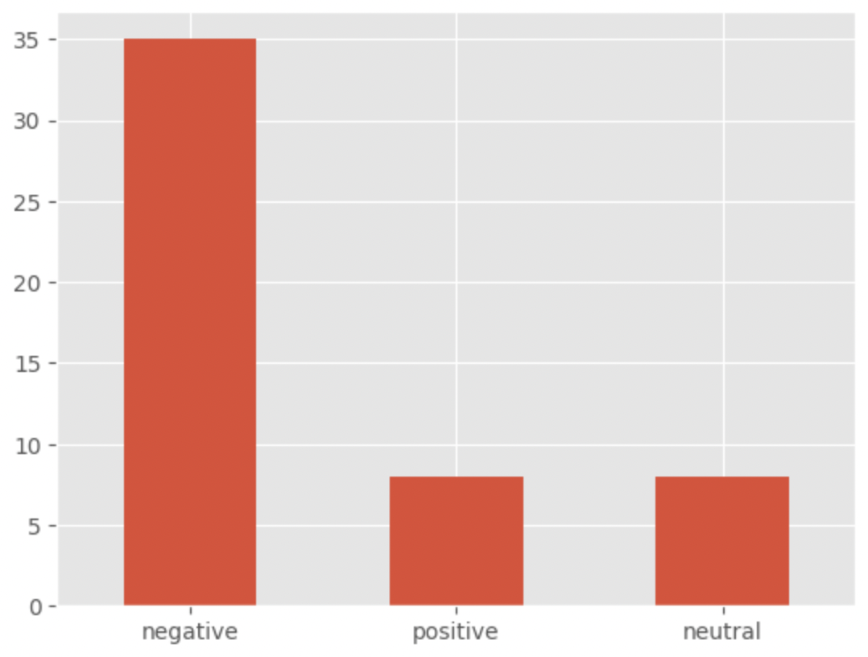
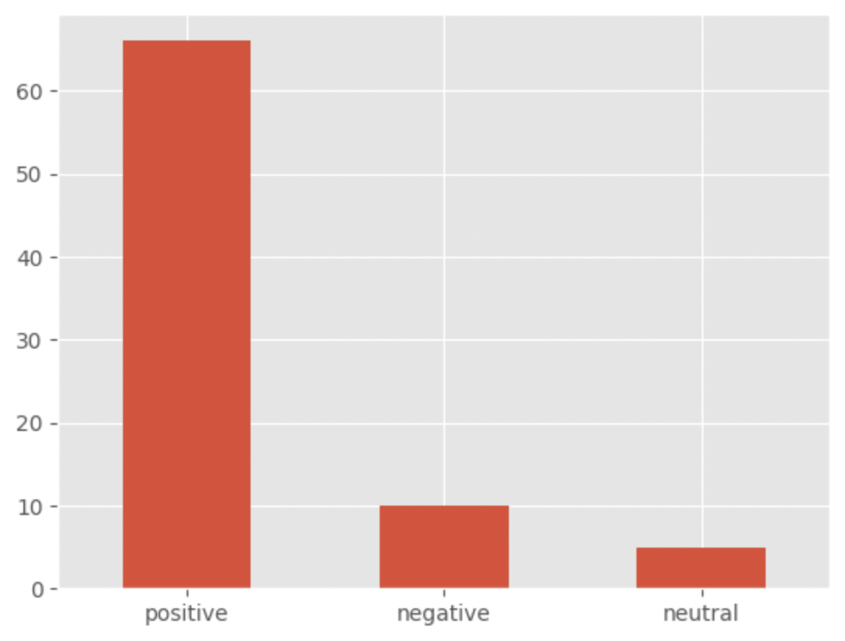
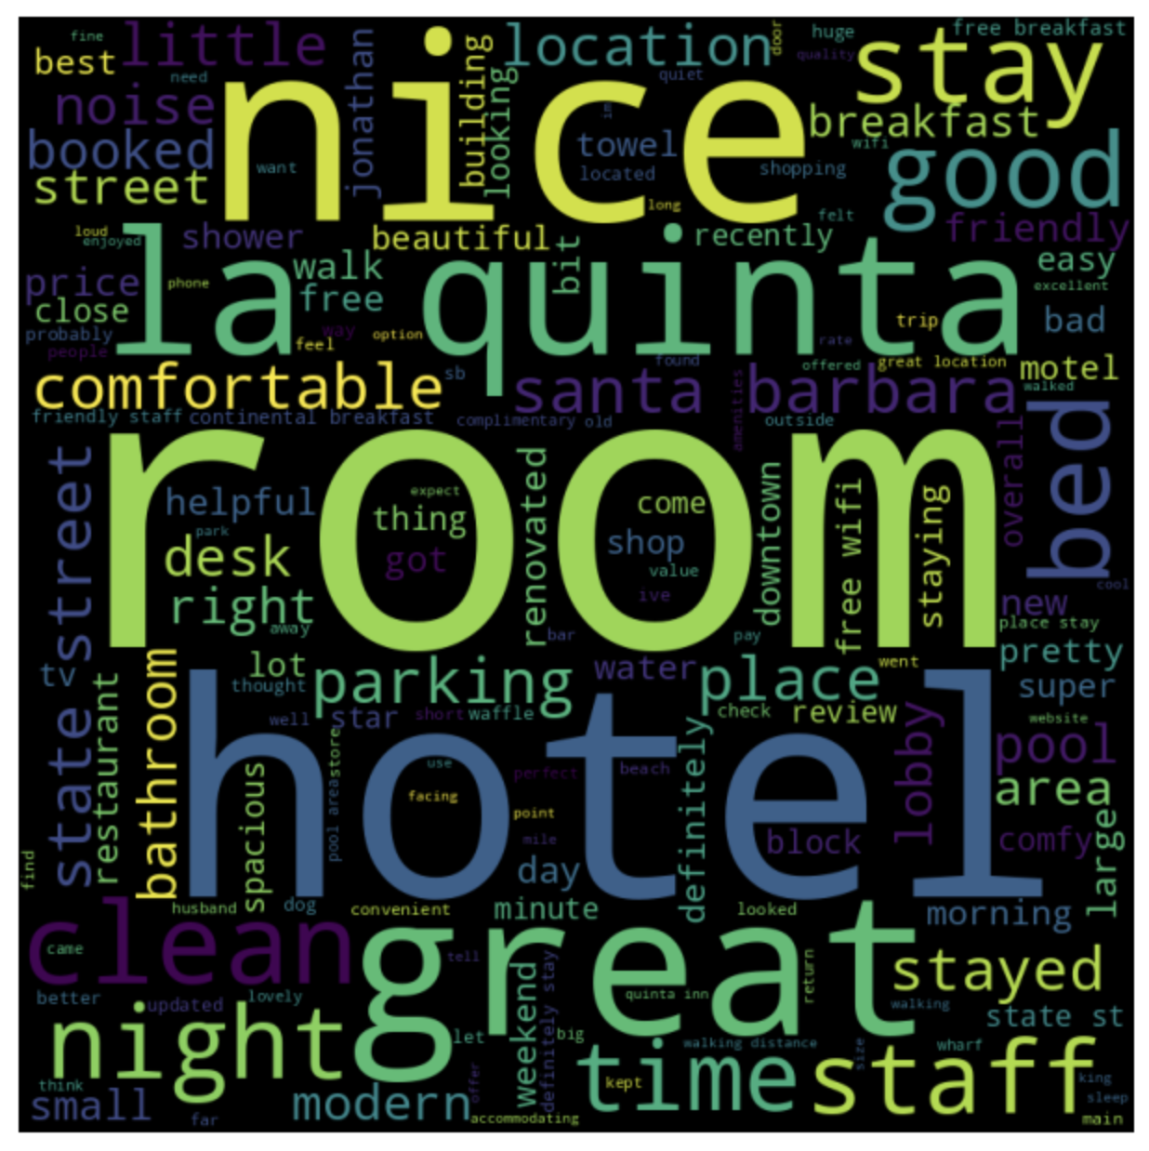
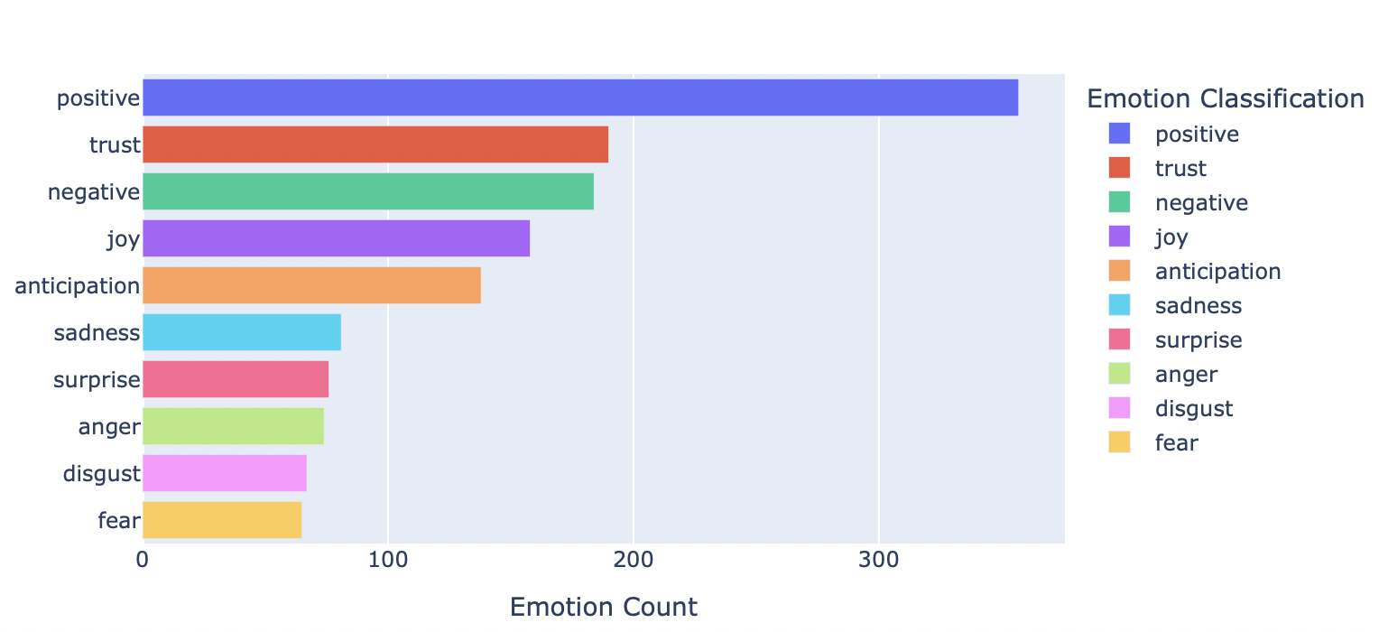
The Rise The Fall
Construction noise
Poor customer service and sanitation conditions
No maintenance
Huge room, big & comfortable bed
Convenient location
Free breakfast

Slide 4
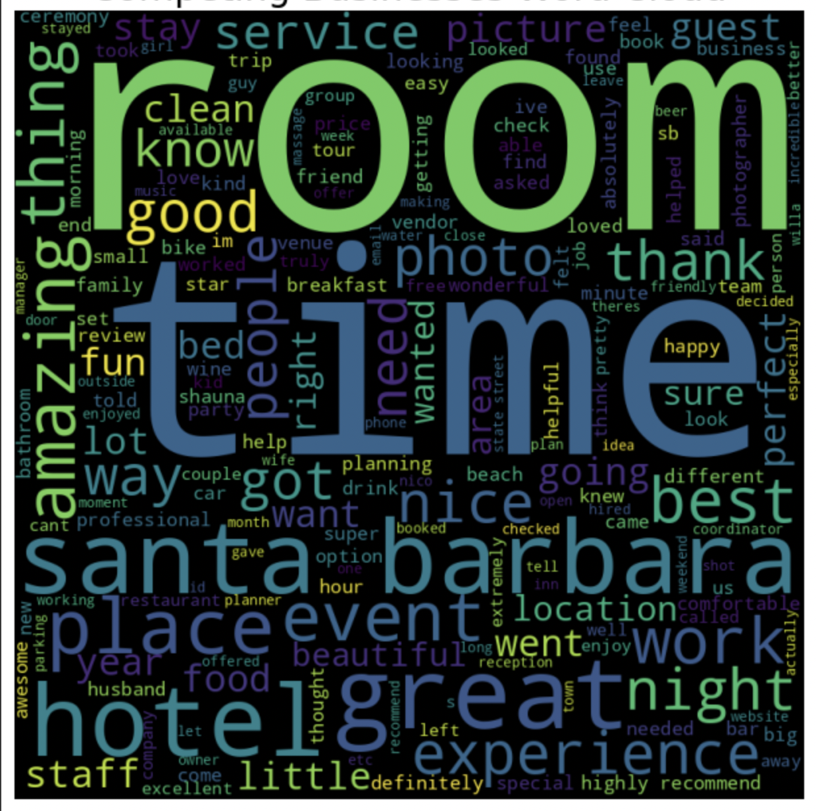
Competition Analysis & Conclusion
What went wrong:
La Quinta did not maintain its property standards
Did not focus on cleanliness
Unsuccessful transition after Covid
No parking
What they could have done:
Upgrade room standard
Collaborate with parking
Accommodate after Covid: resume breakfast policy
We find that the positive reviews for the competing businesses fell mainly into 4 broad topics, location, experience, service and activities.

